Slide 1



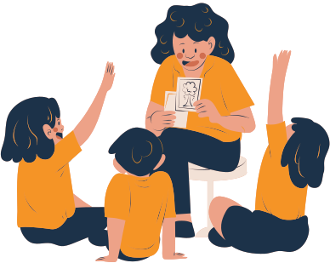
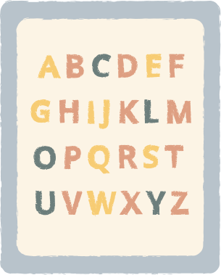



Topic: School
E-Space English Club

Slide 2

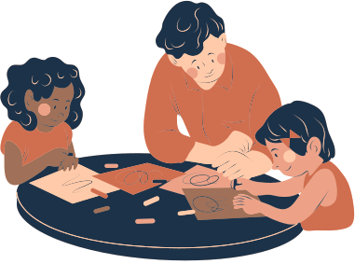
Ask and answer
  How do you get to school each day?
  Do you normally arrive early, on time or late to school?
  Do you like your teachers?
  What is your favorite class in school? What do you like about it?
  Do you like your current learning atmosphere?
  What are some of the most popular activities at your school?

Slide 3

Ask and answer
  Have you ever returned to see your old school again?
  Are you still in contact with any of the friends you had in primary school?
  Do you find school relaxing or stressful?
  If you could change one thing about your school, what would it be?
  If you were a teacher for a day, which subject would you want to teach?

Slide 4

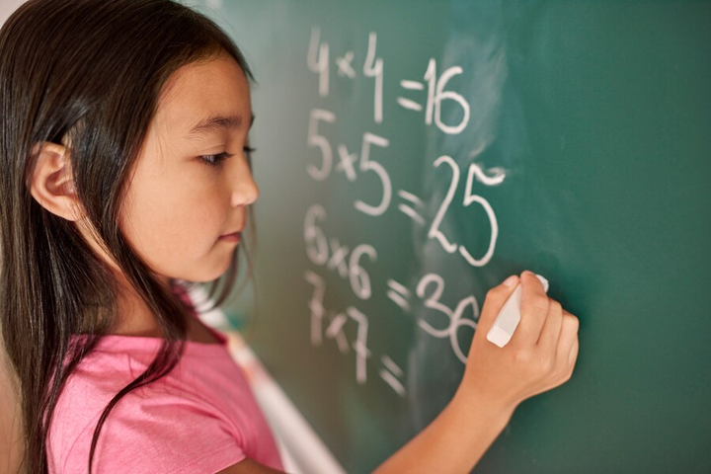
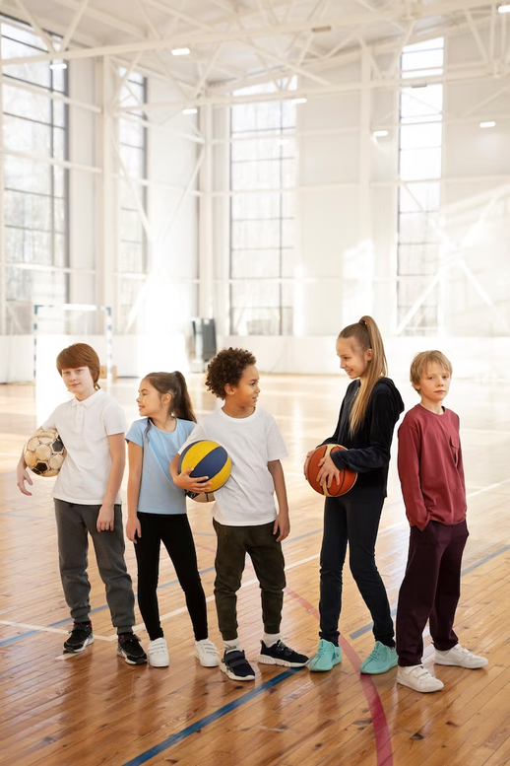
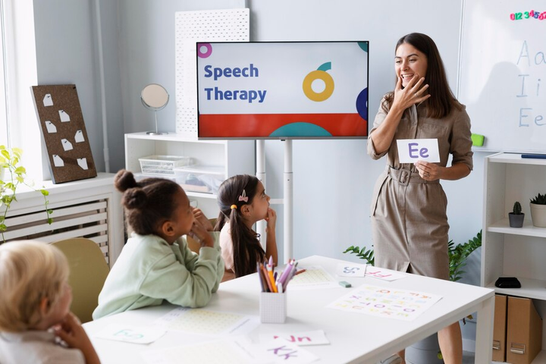
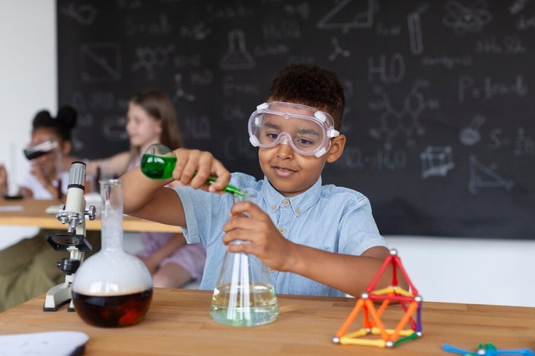
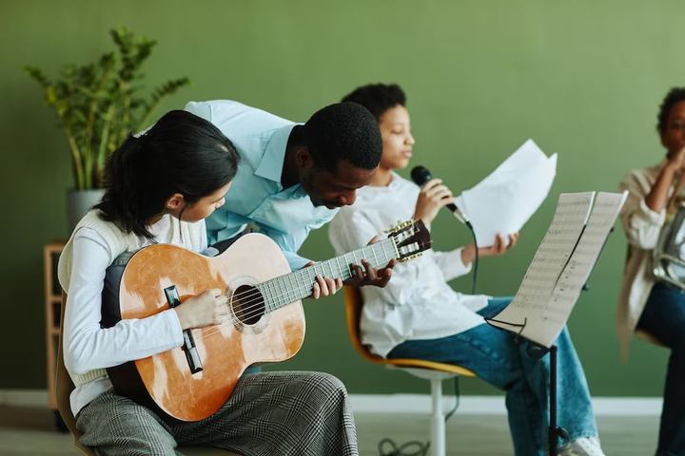
Do you like these different subjects at school? Say why or why not.

Slide 5
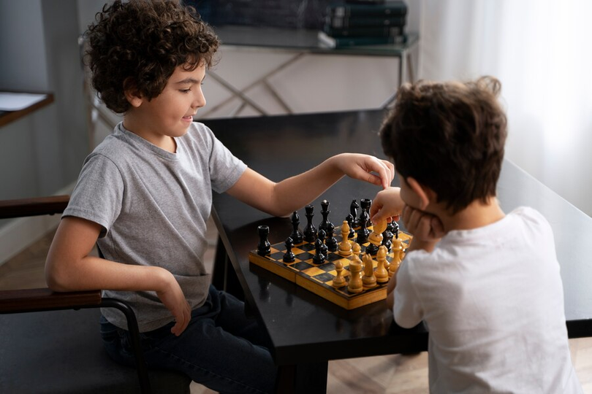
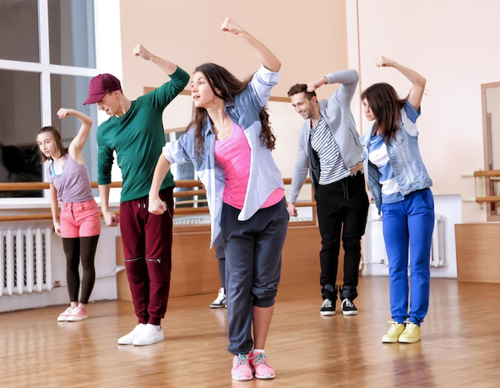
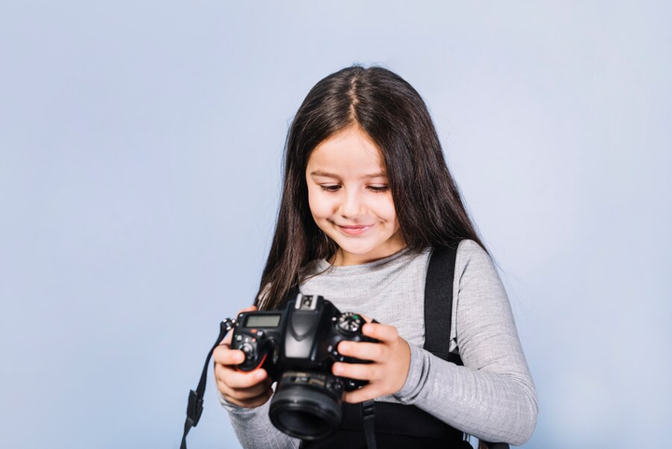
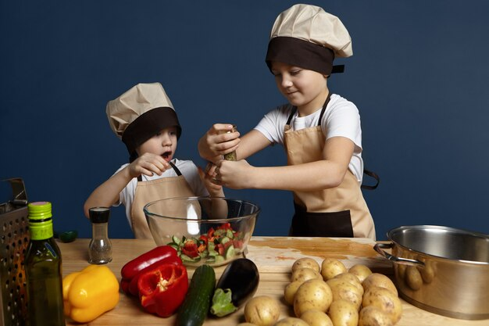

Do you like these different school clubs?
Say why or why not.

Slide 6
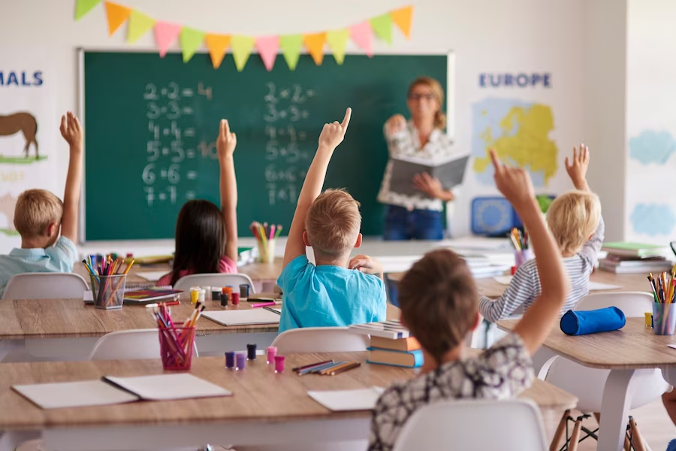
What can you see in this photograph?

Slide 7

What can you see in this photograph?

Slide 8
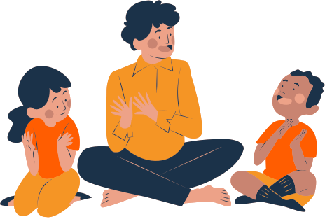
Thank You!

